Slide 1
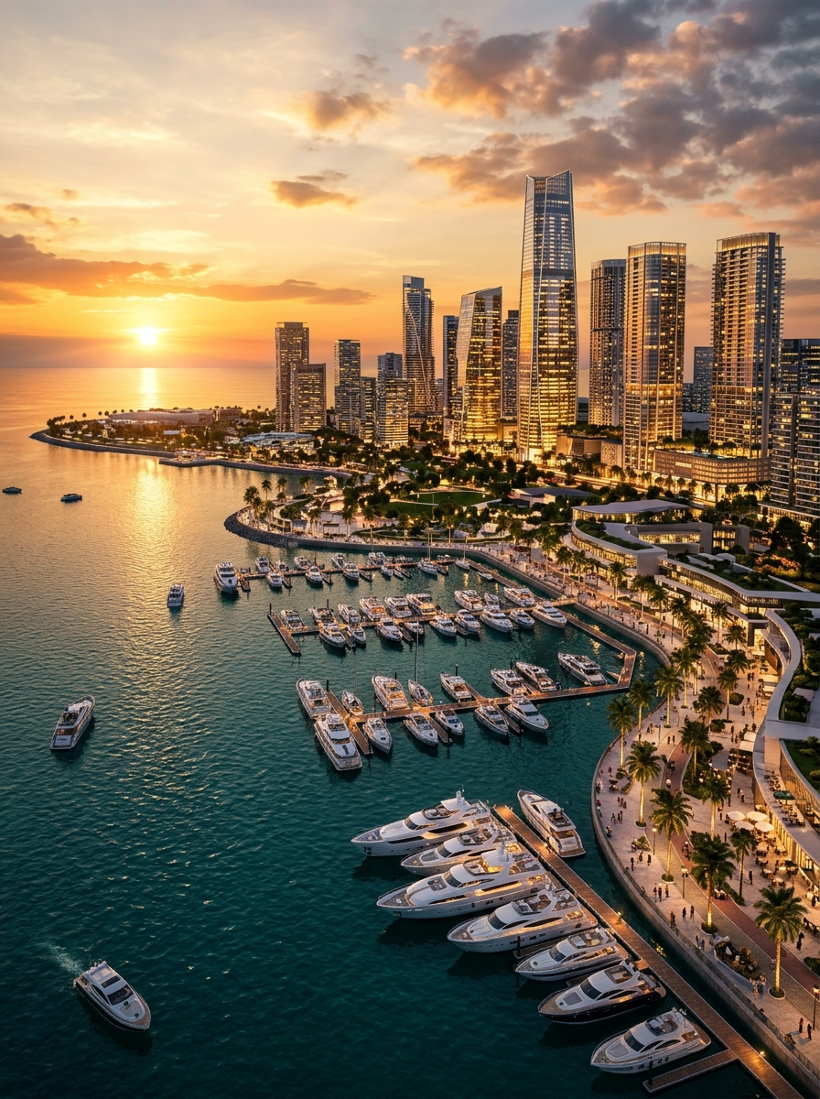


COMPANY PROFILE • 2026
STRATEGIC ADVISORY & INVESTMENT FACILITATION
DESTINATION
CONSULTANCY (PVT) LTD
A premier Sri Lanka-based multidisciplinary management and investment consultancy firm serving as your strategic bridge and execution partner for market entry, project development, sustainability, certification readiness, BPO setup, and digital growth.
01 • INVESTMENT & M&A
02 • ESG & STANDARDS
03 • BPO & DIGITAL
Market Entry, BOI & Port City Advisory, Project Structuring
Sustainability Frameworks, Carbon Accounting & ISO Readiness
Shared Services Setup, AI/CRM Automation & Digital Growth
“Success Beyond Boundaries”
HQ: #14, Basement Level, Cinnamon Lakeside Hotel, Colombo 02 | www.destinationconsultancy.com | +94 11 233 6116

Slide 2
DESTINATION CONSULTANCY (PVT) LTD
CORPORATE OVERVIEW • WHO WE ARE
CORPORATE OVERVIEW • WHO WE ARE
A MULTIDISCIPLINARY ADVISORY PARTNER
Destination Consultancy (Private) Limited is a premier, Sri Lanka-based multidisciplinary management and investment consultancy firm headquartered in Colombo. Positioned at the crossroads of South Asian commerce, we serve as a strategic bridge and execution partner for international investors, global corporations, development agencies, and domestic enterprises.
Whether evaluating market entry under BOI or Colombo Port City frameworks, aligning with international ISO and ESG standards, or building a BPO centre or digital growth engine, we provide integrated end-to-end solutions.
OUR VISION
OUR MISSION
To be the most trusted strategic advisory and execution partner for sustainable investment, enterprise transformation, and cross-border business growth in Sri Lanka and the region.
To empower investors and enterprises with actionable intelligence, seamless regulatory navigation, sustainable frameworks, and end-to-end operational support.
OUR CORE PILLARS
STRATEGIC INSIGHT
REGULATORY NAVIGATION
HANDS-ON EXECUTION
GLOBAL STANDARDS
Data-driven feasibility studies, market intelligence & commercial structuring.
Direct coordination across BOI, Port City Colombo & line ministries.
Supporting incorporation, recruitment, facility setup & launch.
Aligning enterprises with international ISO, ESG & digital best practices.
HOW WE WORK • A CLEAR 4-STEP PATH
01
02
03
04
DISCOVER
STRUCTURE
EXECUTE
SCALE
Understand commercial objectives, market context, regulatory needs & operational priorities.
Design the right market-entry, project finance, compliance, operating or growth model.
Coordinate statutory approvals, documentation, partners, facility setup & delivery milestones.
Support ongoing operational optimisation, ISO/ESG governance, digital adoption & expansion.
DESTINATION CONSULTANCY (PVT) LTD | WWW.DESTINATIONCONSULTANCY.COM
02

Slide 3
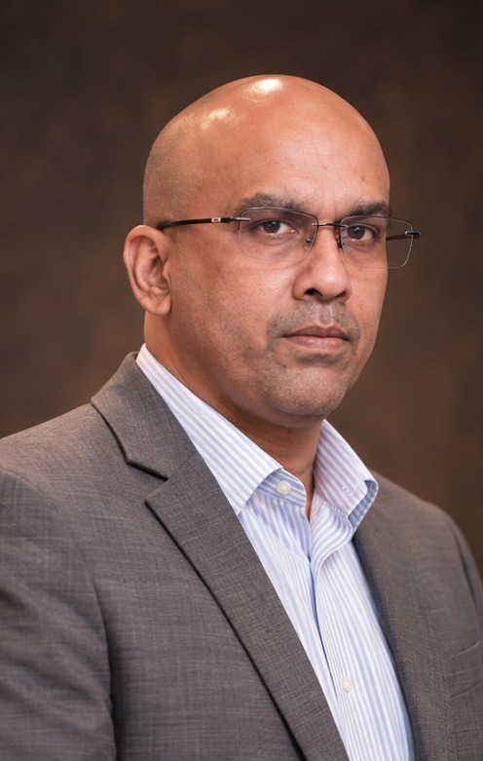
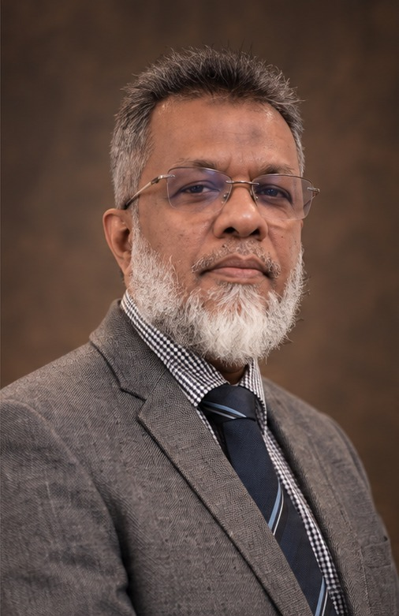
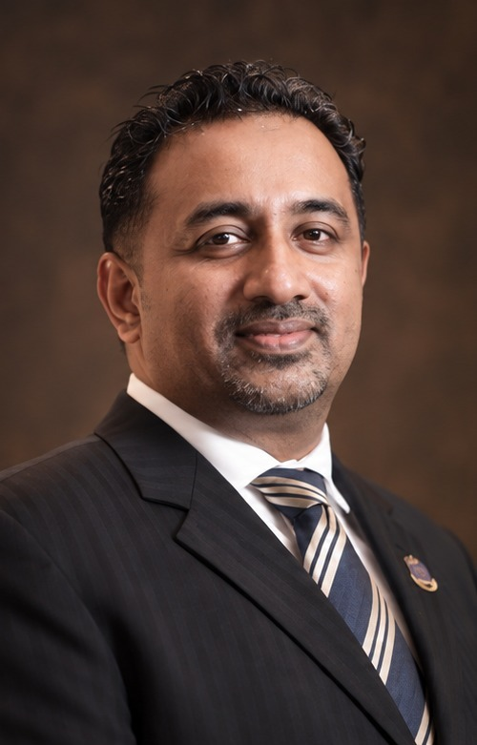
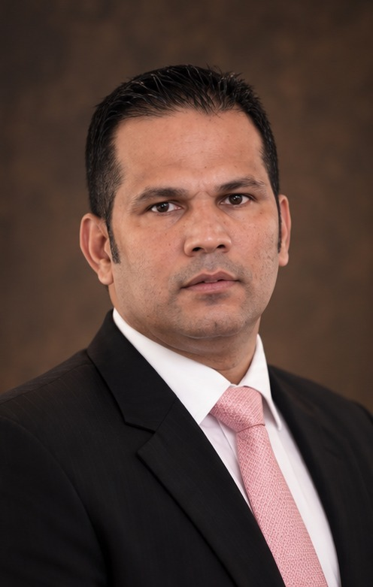
DESTINATION CONSULTANCY (PVT) LTD
LEADERSHIP & GOVERNANCE
LEADERSHIP & GOVERNANCE • SENIOR INVOLVEMENT
BOARD OF DIRECTORS
Shaameel Mohideen
Azad Hamdoon
Executive Director & CEO – Investment Facilitation & Market Entry
Director – Sustainable Infrastructure & Project Development
MBA (Aus), CMA (Aus), MABE (UK), FCPM, AM (SLIM), FSLID, JP
15+ Years in Renewable Energy, Waste Management & Agribusiness
Specialises in BOI and Port City Colombo advisory, government approvals, market entry, corporate services, project structuring, and cross-border partnerships. Provides institutional navigation and investor facilitation.
Brings over 15 years of leadership in renewable energy, waste management, agribusiness infrastructure, and project development. Leads sustainability-linked projects, clean-energy transitions, and on-ground execution.
Faazil Ibrahim
Eardley Kern
Director – Strategy, Digital Transformation & Business Growth
Director – Capital Markets & Investment Advisory
20+ Years Across GCC & South Asia Operations & Digital Strategy
32+ Years in Capital Markets, Financial Services & Corporate Performance
Over 20 years of senior experience across customer success, business operations, digital strategy, and revenue growth in the GCC and South Asia. Connects strategy to execution through BPO capability and digital transformation.
Over 32 years of executive leadership in capital markets and financial services, combining an investment and corporate-performance perspective with marketing leadership. Strengthens funding strategy and investment readiness.
INTEGRATED BOARD-LEVEL STEWARDSHIP
Together, our four directors cover the full commercial lifecycle—Market Entry, Capital Structuring, Sustainable Infrastructure, and Digital & Operational Growth.
DESTINATION CONSULTANCY (PVT) LTD | WWW.DESTINATIONCONSULTANCY.COM
03

Slide 4
DESTINATION CONSULTANCY (PVT) LTD
CONNECTED SERVICES • PART I
SIX CONNECTED PRACTICE AREAS • PART I
INVESTMENT, M&A & SUSTAINABILITY
01
INVESTMENT, FEASIBILITY STUDY & MARKET ENTRY
We guide foreign and domestic investors from initial exploration to legal establishment and commercial launch in Sri Lanka.
• Market-entry strategy & commercial viability assessments
• BOI & Port City Colombo advisory & applications
• Government, ministry & line-agency approvals & licensing
• Company incorporation, secretarial & legal set-up
• Investment opportunity assessment & site selection
• Foreign investor support, visas & banking coordination
• Local representation & stakeholder engagement
• Tax holiday & duty-free concession structuring
02
PROJECT DEVELOPMENT, MERGERS & ACQUISITIONS
We transform high-potential concepts into bankable, investment-ready projects and guide corporate transactions with financial discipline.
• Bankable feasibility studies & financial models
• Investor-grade business plans, pitch decks & IMs
• End-to-end project structuring (PPP, BOT, BOO)
• Project financing facilitation & capital-market advisory
• JV & strategic local/foreign partner matchmaking
• Mergers & acquisitions (M&A) buy/sell-side advisory
• Project management office (PMO) setup & oversight
• Valuation reviews & pre-transaction readiness
03
SUSTAINABILITY & ESG ADVISORY
We help organisations embed Environmental, Social, and Governance (ESG) principles into their core strategy and daily operations.
• Corporate sustainability strategy & ESG frameworks
• Organizational & product carbon-footprint (GHG)
• Sustainability reporting (GRI & ISSB / IFRS S1 & S2)
• Renewable-energy transition & green project advisory
• Circular-economy solutions & resource efficiency
• Sustainable supply chains & UN SDG alignment
DESTINATION CONSULTANCY (PVT) LTD | WWW.DESTINATIONCONSULTANCY.COM
04

Slide 5
DESTINATION CONSULTANCY (PVT) LTD
CONNECTED SERVICES • PART II
SIX CONNECTED PRACTICE AREAS • PART II
ISO SYSTEMS, BPO & DIGITAL GROWTH
04
CERTIFICATION & MANAGEMENT SYSTEMS
End-to-end advisory and implementation support to prepare your organisation for third-party ISO certification audits.
• ISO 9001: Quality Management Systems
• ISO 14001: Environmental Management Systems
• ISO 45001: Occupational Health & Safety
• ISO 27001: Information Security Management
• ISO 22301: Business Continuity Management
• ISO 22000 / HACCP: Food Safety Management
• Gap assessments, policy/SOP drafting & training
• Pre-audit readiness reviews (accredited body certifies)
05
BPO SETUP & SHARED SERVICES SUPPORT
Turnkey BPO setup and operational scaling for international companies building captive shared-service centres or outsourcing hubs.
• BPO feasibility studies & operating-model design
• Incorporation, BOI IT/BPO concessions & facility setup
• Talent acquisition strategy, recruitment & onboarding
• End-to-end process mapping, SLA definition & SOPs
• Quality assurance (QA) & KPI performance systems
• Technology stack setup, IT & data security
06
DIGITAL GROWTH & TECHNOLOGY
Combining strategic marketing, modern search visibility (SEO/AEO/GEO), software engineering, and enterprise IT support.
• Digital strategy, B2B/B2C demand & lead generation
• Brand identity, positioning & content strategy
• Search visibility across SEO, AEO & GEO
• Custom website, portal & enterprise app development
• CRM implementation & marketing automation
• Data analytics, BI dashboards, AI & managed IT
DESTINATION CONSULTANCY (PVT) LTD | WWW.DESTINATIONCONSULTANCY.COM
05

Slide 6
DESTINATION CONSULTANCY (PVT) LTD
WHY SRI LANKA & 5-HUB VISION
DESTINATION SRI LANKA • STRATEGIC INVESTMENT GATEWAY
WHY SRI LANKA & THE FIVE-HUB VISION
Positioned at the centre of the Indian Ocean along the world’s busiest East–West maritime trade route, Sri Lanka offers unmatched connectivity to South Asia, the Middle East, Africa, East Asia, and Europe—combining deep-water ports, Colombo Port City, and an educated workforce.
65,610 km²
445 × 225 km
27.5 °C
Since 1948
TOTAL LAND AREA
LENGTH × WIDTH
MEAN TEMPERATURE
SOVEREIGN REPUBLIC
THE FIVE-HUB STRATEGIC FRAMEWORK
HUB 01
HUB 02
HUB 03
HUB 04
HUB 05
MARITIME HUB
AVIATION HUB
COMMERCIAL HUB
ENERGY HUB
KNOWLEDGE HUB
Deep-water ports in Colombo, Hambantota & Trincomalee serving East–West shipping lanes.
Expanding international air cargo & passenger connectivity across South Asia, GCC & APAC.
Colombo Port City & modernised BOI regimes creating an offshore financial centre.
Abundant solar, wind, hydro & green-hydrogen potential driving clean-energy investment.
High literacy, English proficiency & globally recognised accounting, IT & engineering talent.
HIGH-POTENTIAL INVESTMENT SECTORS
RENEWABLE ENERGY
BPO, IT & SHARED SERVICES
TOURISM & HOSPITALITY
Utility-scale solar, wind, biomass, mini-hydro, battery storage & waste-to-energy.
Finance & accounting, software engineering, AI data ops & customer experience.
Luxury eco-resorts, wellness tourism, integrated marinas & boutique hotels.
SUSTAINABLE AGRIBUSINESS
EXPORT MANUFACTURING
URBAN INFRASTRUCTURE
Value-added Ceylon tea, spices, coconut derivatives, aquaculture & cold-chain.
High-value apparel, rubber products, electronics assembly & pharmaceuticals.
Commercial towers, mixed-use Port City developments, industrial zones & healthcare.
DESTINATION CONSULTANCY (PVT) LTD | WWW.DESTINATIONCONSULTANCY.COM
06

Slide 7
DESTINATION CONSULTANCY (PVT) LTD
INVESTOR FACILITATION & REGULATORY GATEWAY
INSTITUTIONAL NAVIGATION • REGULATORY CLEARANCES
INVESTOR FACILITATION & GATEWAY
BOI
Board of Investment Approvals
CPCC
Colombo Port City Advisory
Full lifecycle representation under Section 17 (special incentive regime) and Section 16 (normal law foreign investment entry) of the BOI Act.
• Investment application preparation & financial projections
• Negotiation & execution of BOI Investment Agreements
• Customs duty-free import clearance for project capital goods
• Expatriate entry permits & residence visa recommendations
Advisory for international businesses establishing offshore entities inside the Colombo Port City Special Economic Zone.
• Authorised Person (AP) licensing & offshore registration
• Business of Strategic Importance (BSI) incentive structuring
• Designated foreign-currency banking & capital mobility
• Leasehold plot & commercial office space coordination
CBSL
Foreign Exchange & Banking
LINE
Line-Ministry & Sector Approvals
Compliant capital inflow structuring under the Foreign Exchange Act and Central Bank of Sri Lanka (CBSL) directions.
• Inward Investment Account (IIA) opening with licensed banks
• Equity remittance, shareholder loan & repatriation structuring
• ROC eBiz company incorporation & corporate secretarial setup
• IRD tax registration (TIN, Corporate Income Tax, VAT, SVAT)
Multi-agency environmental, municipal, and sector-specific approvals required for physical project execution.
• Central Environmental Authority (CEA) IEE / EIA & EPL clearances
• Urban Development Authority (UDA) & local authority permits
• Sri Lanka Sustainable Energy Authority (SLSEA) & CEB approvals
• Sri Lanka Tourism Development Authority (SLTDA) licensing
SINGLE-WINDOW EXECUTION ADVANTAGE: Rather than managing separate legal, engineering, environmental, and corporate consultants, investors rely on Destination Consultancy as a unified project management office (PMO) that coordinates every regulatory milestone from day one.
DESTINATION CONSULTANCY (PVT) LTD | WWW.DESTINATIONCONSULTANCY.COM
07

Slide 8
DESTINATION CONSULTANCY (PVT) LTD
REPRESENTATIVE ADVISORY MANDATES
INDUSTRIES & PROJECTS • PRACTICAL EXECUTION
REPRESENTATIVE ADVISORY MANDATES
01 • INFRASTRUCTURE & MIXED-USE
02 • RENEWABLE ENERGY & CLEAN TECH
Market Entry & Regulatory Structuring
Feasibility & Sustainability Framework
Structured local incorporation, BOI application strategy, line-ministry approvals, and land/lease due diligence for a regional development consortium entering Sri Lanka.
Delivered commercial feasibility modelling, environmental alignment, grid-connection coordination, and ESG reporting frameworks for a utility-scale solar and biomass initiative.
03 • BPO & KNOWLEDGE SERVICES
04 • EXPORT MANUFACTURING
Turnkey Shared-Services Center Setup
Integrated ISO Systems Readiness
Designed the operating model, secured BOI IT/BPO concessions, established facility infrastructure, mapped SOPs, and guided initial recruitment for a GCC-backed support hub in Colombo.
Conducted gap assessments, developed integrated manuals, trained internal auditor teams, and prepared an export manufacturer for successful ISO 9001, 14001 & 45001 audits.
05 • TECHNOLOGY & DIGITAL
06 • TOURISM & HOSPITALITY
Digital Transformation & Demand Gen
Eco-Resort Investment Advisory
Rebuilt corporate digital presence, implemented CRM pipeline automation, and deployed SEO, AEO, and GEO content strategies to expand international B2B inbound inquiries.
Advised foreign promoters on SLTDA approvals, environmental clearances, capital structuring, and sustainable operations for a boutique coastal hospitality asset.
LOOKING FOR INVESTMENT OPPORTUNITIES OR PROJECT MATCHMAKING?
We maintain an active pipeline of vetted Sri Lankan projects in renewable energy, hospitality, agribusiness, BPO, and manufacturing.
DESTINATION CONSULTANCY (PVT) LTD | WWW.DESTINATIONCONSULTANCY.COM
08

Slide 9

DESTINATION CONSULTANCY (PVT) LTD
CONNECT WITH OUR ADVISORY TEAM
CONNECT WITH OUR ADVISORY TEAM
CONTACT US
Destination Consultancy (Pvt) Ltd
REGISTERED OFFICE ADDRESS:
#14, Basement Level, Cinnamon Lakeside Hotel,
No. 115, Sir Chittampalam A. Gardiner Mawatha,
Colombo 02, Sri Lanka.
TELEPHONE & DIRECT HOTLINES:
General Lines: +94 11 233 6116 | +94 11 249 2821
Direct Hotlines: +94 77 779 0919 | +94 75 675 3877
DIGITAL & OFFICIAL PORTAL:
Email: info@destinationconsultancy.com
Website: www.destinationconsultancy.com
SCAN TO VISIT WEBSITE
destinationconsultancy.com
SCHEDULE AN EXECUTIVE CONSULTATION
“Success Beyond Boundaries”
Strategic Insight • Regulatory Navigation • Hands-On Execution
Market Entry & BOI | Project Structuring & M&A | Sustainability & ESG | ISO Readiness | BPO Setup | Digital Growth
DESTINATION CONSULTANCY (PVT) LTD | WWW.DESTINATIONCONSULTANCY.COM
09

